Slide 1
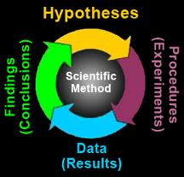
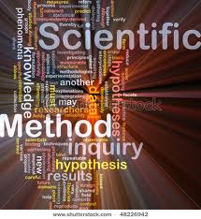
Rethinking Theory: #2 METHODOLOGY
Does Black Studies have/need method?
Abdul Alkalimat, University of Illinois
September 27, 2011

Slide 2
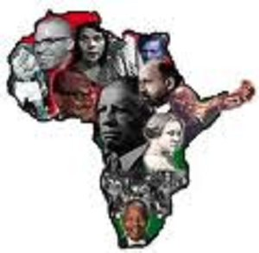
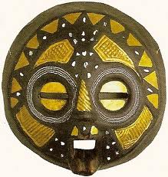
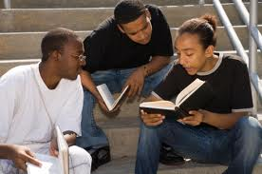
http://ensemble.atlas.uiuc.edu/app/sites/qzBpeuKc0E6NPaVC9tPfzA.aspx?destinationID=qzBpeuKc0E6NPaVC9tPfzA&contentID=ucUbNCG470mburuzv2c-hQ
Lecture #1
Black Studies
Ideological
Framework
Identity
Analysis
Commitment
Program
Action

Slide 3
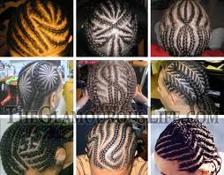
Lecture #2; What methods
… are in Black intellectual history?
…do we need today?

Slide 4
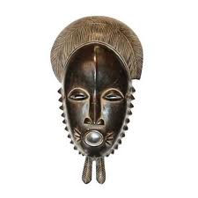
Lecture #2: Method
What is method in Black Studies?
The dialectics of method
The crisis of racism
Key debates over Black
agency
What is the D – 7 Method we need?

Slide 5
What is method?
Specifically, what is method
for the production of knowledge
In Black Studies?
Epistemology
Sociology
History
Comparative

Slide 6
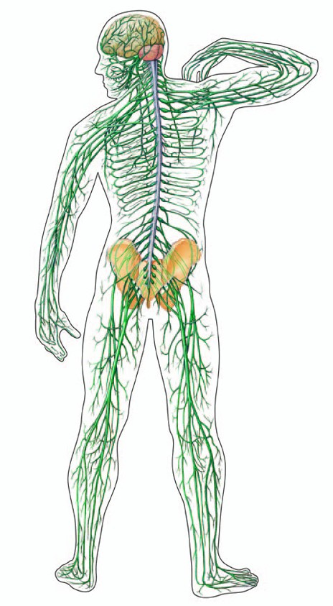
Epistemology: a theory of knowledge
Perceptual knowledge – using our
five senses to gather sense perceptions
of the world around us
Rational knowledge – using our
brains to analyse (name and code)
these perceptions to find meaning
Practical knowledge – verification
by using rational knowledge in
practical application

Slide 7
Sociology helps us understand
that knowledge production is
a social process
Peer review
Consensus
Unity of action

Slide 8
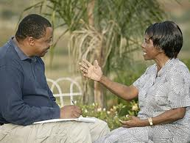
Historical analysis
helps us to understand
that knowledge forms
change over historical time
Oral
history
Written
history
Digital
history

Slide 9
Comparative study
helps us maintain a
global perspective

Slide 10
There are five domains
or sources of knowledge
1. Science – academic
scholarship
2. Production – economic development
3. Social struggle – society
4. Culture – values of everyday life, art
5. Archive - institutionalized memory

Slide 11
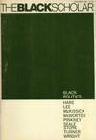
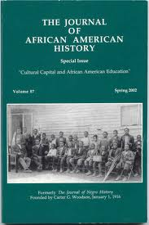
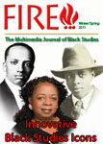
The Black experience:
Production
Social Struggles
Culture
Archives
Black Studies
Academic scholarship

Slide 12
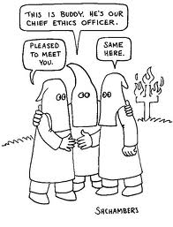
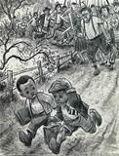
Racism:
The crisis of knowledge production

Slide 13
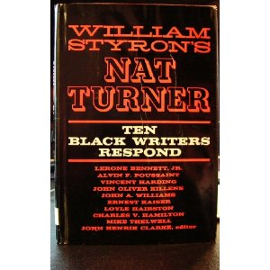
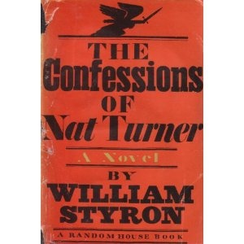
Four late 20th century critical debates
against racism in academic scholarship: #1
1966
1969

Slide 14
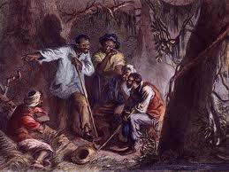
The historical Nat Turner:
“dangerous religious
lunatic, . . . a
psychopathic monster.”
William Styron
Lerone Bennett

Slide 15
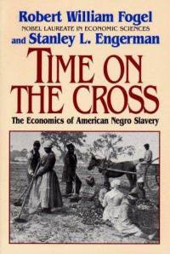
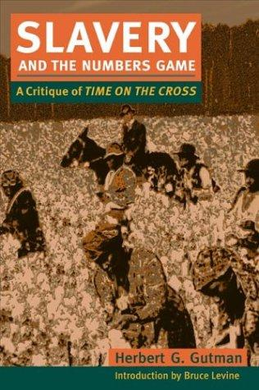
Four late 20th century critical debates
against racism in academic scholarship: #2
1974
1975

Slide 16
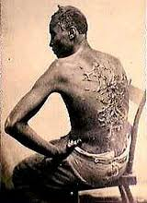
The challenge of using statistical data
Slaves experienced "an
average of 0.7 whippings
per hand per year.“
Fogel and Engerman
"A slave -- on average –
was whipped every 4.56
days.“
Herbert Gutman

Slide 17
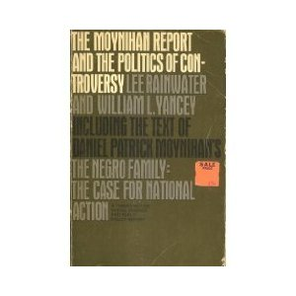
Four late 20th century critical debates
against racism in academic scholarship: #3
1965
1967

Slide 18
Pathology versus “Strength of Black families”
“At the heart of the deterioration of the fabric of Negro
society is the deterioration of the Negro family. It is the
fundamental source of the weakness of the Negro
community at the present time.” Daniel Patrick Moynihan
Robert Hill

Slide 19
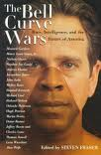
Four late 20th century critical debates
against racism in academic scholarship: #4
1994
1995

Slide 20
Race and IQ:
Both anti-scientific concepts run amok
Putting it all together, success and failure in the American
economy, and all that goes with it, are increasingly a matter
of the genes that people inherit.”
Richard Herrnstein and Charles Murray
There is certainly no such support for a genetic interpretation... . It is sometimes suggested that the Black/ White differential in psychometric intelligence is partly due to genetic differences (Jensen, 1972). There is not much direct evidence on this point, but what little there is fails to support the genetic hypothesis.”
American Psychological Association
Disturbing as I find the anachronism of The Bell Curve, I am even more
Distressed by its pervasive disingenuousness. The authors omit facts,
misuse statistical methods, and even seem unwilling to Admit the
consequences of their own words.” Stephen Jay Gould

Slide 21
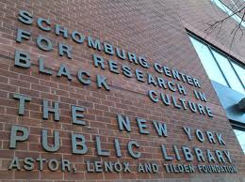
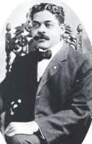

Slide 22
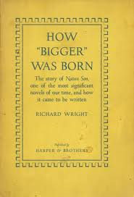
Richard Wright
(1908 – 1960)
The Bigger Thomases were the only
Negroes I know of who consistently
violated the Jim Crow laws of the
South and got away with it, at least
for a sweet brief spell. Eventually,
the whites who restricted their lives
made them pay a terrible price.
They were shot, hanged, maimed,
lynched, and generally hounded
until they were either dead or their
spirits broken

Slide 23
Margaret Walker
(1915 – 1998)
I always intended Jubilee to
be a folk novel based on folk
material: folk sayings, folk
belief, folkways. As early as
1948 I was conceiving the
story in terms of this folklore.
I also wanted the book to be
realistic and humanistic. I
intended this twin standard
to prevail, and I wanted to
press this leit-motif of the
biblical analogy of Hebrews
in Egypt with Black folk in
America.

Slide 24
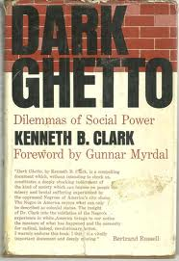
The utility of Black Agency:
Getting inside the Black experience
“The method of study has much in
common with the more traditional
methods of a participant observer….
The role of the “involved observer”
however differs…in that it demands
participation not only in rituals and
customs but in the social competition
with the hierarchy in dealing with the
problems of the people he is seeking
to understand.” (1967)

Slide 25
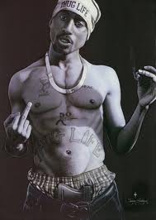
The debate over Black agency:
Insiders versus
outsiders
Analysts versus
advocates
The ad hominem
fallacy
Gender bias

Slide 26
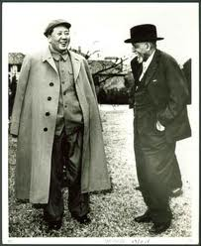
W. E. B. DuBois (1935)
What is the object of writing the history
of Reconstruction? Is it to wipe out the
disgrace of a people which fought to
make slaves of Negroes? Is it to show
that the North had higher motives than
freeing black men? Is it to prove that
Negroes were black angels? No, it is
simply to establish the Truth, on which
Right in the future may be built. We
shall never have a science of history until we have in our colleges
men who regard the truth as more important than the defense
of the white race, and who will not deliberately encourage
students to gather thesis material in order to support a prejudice
or buttress a lie.
DuBois with Mao Tse-Tung.

Slide 27
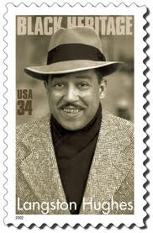
Langston Hughes (1926)
We younger Negro artists who create now
intend to express our individual dark-skinned
selves without fear or shame. If white people
are pleased we are glad. If they are not, it
doesn't matter. We know we are beautiful. And ugly too.
The tom-tom cries and the tom-tom laughs. If colored
people are pleased we are glad. If they are not, their
displeasure doesn't matter either. We build our temples
for tomorrow, strong as we know how, and we stand on top
of the mountain, free within ourselves.

Slide 28
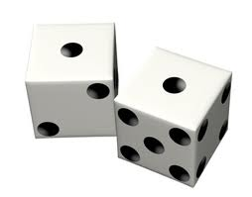
The D-7 Method:
A framework for Black Studies methodology
D-1 Definition: What is the research question?
D-2 Data: What material is being studied?
D-3 Digitization: How to put the data into cyberspace
D-4 Discovery: What are the findings?
D-5 Design: Who is your audience?
D-6 Distribution: How do you spread the word?
D-7 Difference: So what?

Slide 29
D-1: Definition
Where do questions come from?
Friends and family
Academic discussion
Community debate
Scholarly literature
What are they made of?
Concepts
Propositions

Slide 30
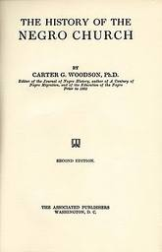
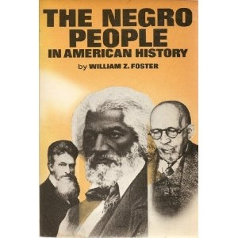
Lit review requires three sources:
African American intellectual history
Mainstream academic scholarship
Radical critiques

Slide 31
Definition of a research problem
means turning concepts into variables
for analysis
Dependent variable
Independent variables
Operationalize variables

Slide 32
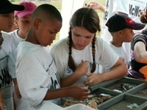
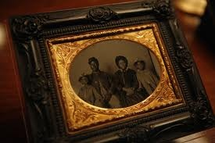
D-2: Data
All of our research is
based on empirical
evidence
Artifacts
People
Social situations

Slide 33
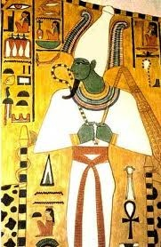
Research on artifacts:
What:
a. Written material
b. Material culture
c. Audio-Visual documents
d. Digital records
Where:
a. Contemporary social life
b. Archives and libraries
c. Cyberspace
d. Archeological digs
(By Black people is more
Important that about them)

Slide 34
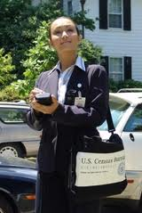
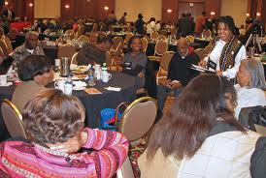
Research on people:
Interviews
Focus group
Observation
(listening to and respecting
the voice of Black people)

Slide 35
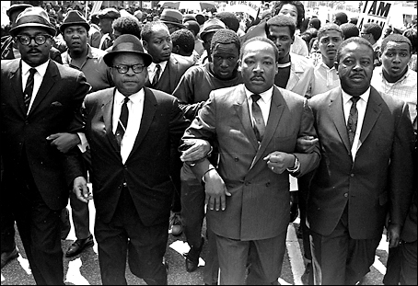
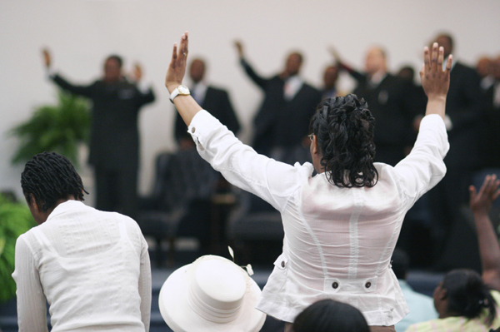
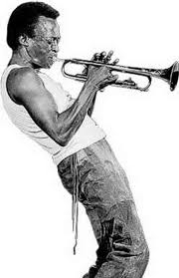
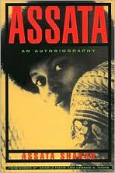
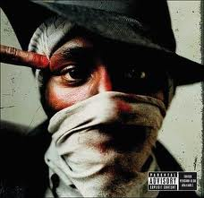
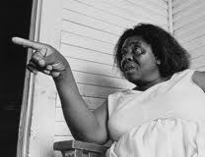
Research on social situations
Living moments
Movements/events
Total immersion in
institutional settings
internal life of the community
access to the Black “normal”

Slide 36
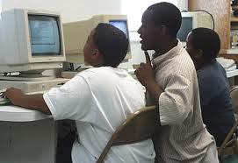
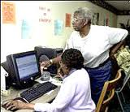
D-3: Digitization
Our work can be guided by three values:
Cyberdemocracy
Collective intelligence
Information freedom

Slide 37
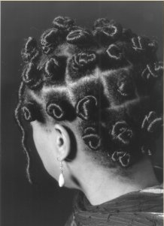
Three kinds of digitization
Digitization of scholarship
Digitization of experience
Digitization of discourse

Slide 38
What’s new by going digital?
Greater collaboration/sharing
Distance doesn’t matter
File management & retrieval
Faster
Cheaper

Slide 39
D-4: Discovery
We answer research questions
in both quantitative and
qualitative terms
We test our finding by what
is peer reviewed in African
American intellectual history
We evaluate how our findings
impact the community
quality of life

Slide 40
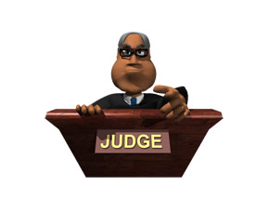
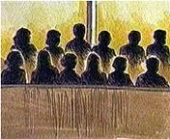
There are three kinds of results
from all research
Affirm existing findings
Refute existing findings
Fill a silence in the literature
Jury

Slide 41
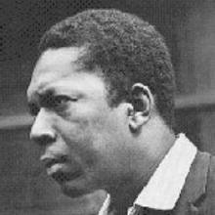
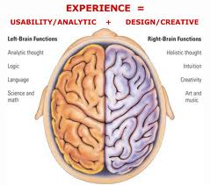
The dialectics of discovery
Three steps:
Description
Explanation
Generalization
Two sides of your brain:
Reason (logic)
2. Emotion (feeling)

Slide 43
D-5: Design form of presentation
Text
Article
Poster
Op-ed
Film
Performance
Lecture
Panel
Interview
concert

Slide 44
Design history of a Black Studies textbook

Slide 45
D-6: Distribution means publishing
How?
1. Always start with a digital file
Journal article is supreme
Share draft with colleagues
The Listserv is fastest to the most
Multiple formats and reprinting
Campus and community
Always share with family & friends
Perishing is not an option!

Slide 46
D-7: Difference
We have to answer the question,
“So what?”

Slide 47
D-7: Remember the mission:
Academic excellence
And
Social Responsibility

Slide 48
The D-7 Method
A framework for Black Studies methodology
D-1 Definition: What is the research question?
D-2 Data: What material is being studied?
D-3 Digitization: Put data into cyberspace
D-4 Discovery: What are the findings?
D-5 Design: Who is your audience?
D-6 Distribution: How to spread the word?
D-7 Difference: So what?

Slide 49
Papers for further study:
BRAIN: Black research archive on the Internet
http://murchisoncenter.org/acrl/
Harold Washington and Black Studies Methodology
http://eblackchicago.org/HAROLD/pdf/2.pdf
Cyberorganizing
http://eblackstudies.org/grbk/

Slide 50
Thank you for watching. Please send comments to
H-Afro-Am@H-Net.msu.edu

